Slide 1
Chapter 6: Project Schedule Management
Information Technology Project Management, Ninth Edition
Note: See the text itself for full citations

Slide 2
Learning Objectives (1 of 2)
Illustrate the importance that project schedules and good project schedule management can have in helping to make projects successful
Discuss the process of planning schedule management
Define activities as the basis for developing project schedules
Describe how project managers use network diagrams and dependencies to assist in activity sequencing
Explain how various tools and techniques help project managers perform activity duration estimates
Use a Gantt chart for planning and tracking schedule information, find the critical path for a project, and describe how critical chain scheduling and the Program Evaluation and Review Technique (PERT) affect schedule development

Slide 3
Learning Objectives (2 of 2)
Compare how schedule management is addressed using Agile vs. more predictive project approaches
Discuss how reality checks and discipline are involved in controlling and managing changes to the project schedule
Describe how project management software can assist in project schedule management and review words of caution before using this software
Discuss considerations for agile/adaptive environments

Slide 4
The Importance of Project Schedules (1 of 3)
Managers often cite delivering projects on time as one of their biggest challenges
Time has the least amount of flexibility; it passes no matter what happens on a project
Individual work styles and cultural differences may also cause schedule conflicts
Different cultures and even entire countries have different attitudes about schedules

Slide 5
The Importance of Project Schedules (2 of 3)
Project time management processes
Planning schedule management
Defining activities
Sequencing activities
Estimating activity resources
Estimating activity durations
Developing the schedule
Controlling the schedule

Slide 6
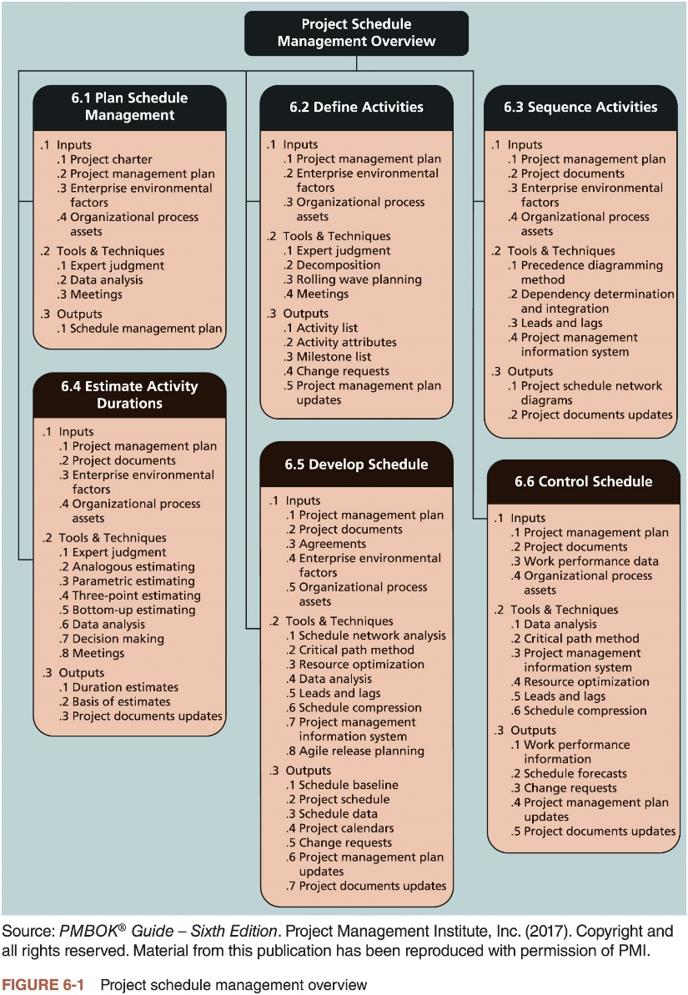
The Importance of Project Schedules (3 of 3)

Slide 7
Planning Schedule Management
Elements of a schedule management plan
Project schedule model development
Scheduling methodology
Level of accuracy and units of measure
Control thresholds
Rules of performance measurement
Reporting formats
Process descriptions

Slide 8
Defining Activities (1 of 2)
Defining activities involves identifying the specific actions that will produce the project deliverables in enough detail to determine resource and schedule estimates
Activity list: a tabulation of activities to be included on a project schedule
Activity name, activity identifier or number, and brief description of the activity
Activity attributes provide more information
Predecessors, successors, logical relationships, leads and lags, resource requirements, constraints, imposed dates, and assumptions related to the activity

Slide 9
Defining Activities (2 of 2)
A milestone is a significant event that normally has no duration
It often takes several activities and a lot of work to complete a milestone
They’re useful tools for setting schedule goals and monitoring progress
Examples: obtaining customer sign-off on key documents or completion of specific products

Slide 10
Sequencing Activities (1 of 6)
Sequencing process involves evaluating the reasons for dependencies and the different types of dependencies
A dependency or relationship is the sequencing of project activities or tasks
Mandatory dependencies: inherent in the nature of the work being performed on a project, sometimes referred to as hard logic
Discretionary dependencies: defined by the project team, sometimes referred to as soft logic. and should be used with care since they may limit later scheduling options
External dependencies: involve relationships between project and non-project activities

Slide 11
Sequencing Activities (2 of 6)
Network diagrams are the preferred technique for showing activity sequencing
Schematic display of the logical relationships among, or sequencing of, project activities
Two main formats are the arrow and precedence diagramming methods

Slide 12
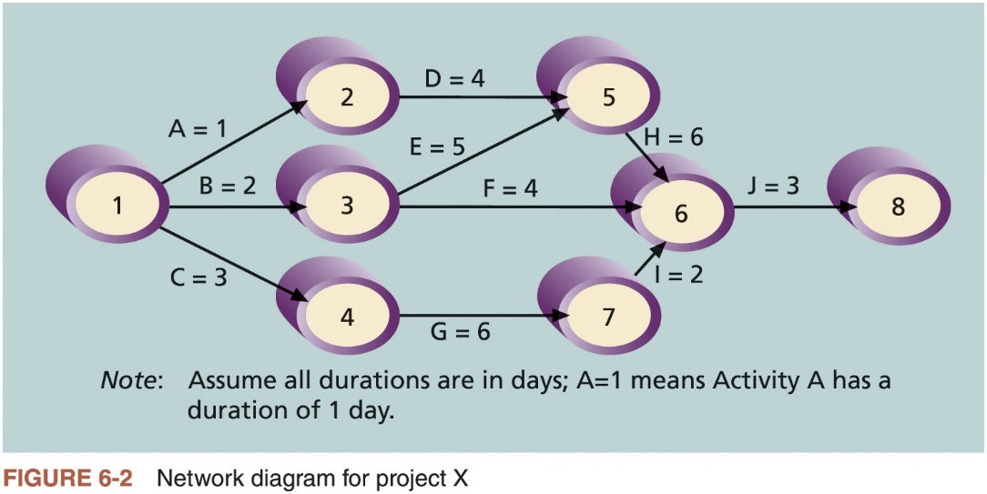
Sequencing Activities (3 of 6)

Slide 13
Sequencing Activities (4 of 6)
Arrow diagramming method (ADM) (i.e., activity-on-arrow network diagrams)
Activities are represented by arrows
Nodes or circles are the starting and ending points of activities
Only show finish-to-start dependencies
Refer to the text for the step-by-step process of creating AOA diagrams
Precedence diagramming method (PDM)
Network diagramming technique in which boxes represent activities
Types of dependencies or relationships between activities
Finish-to-start
Start-to-start
Finish-to-finish
Start-to-finish

Slide 14
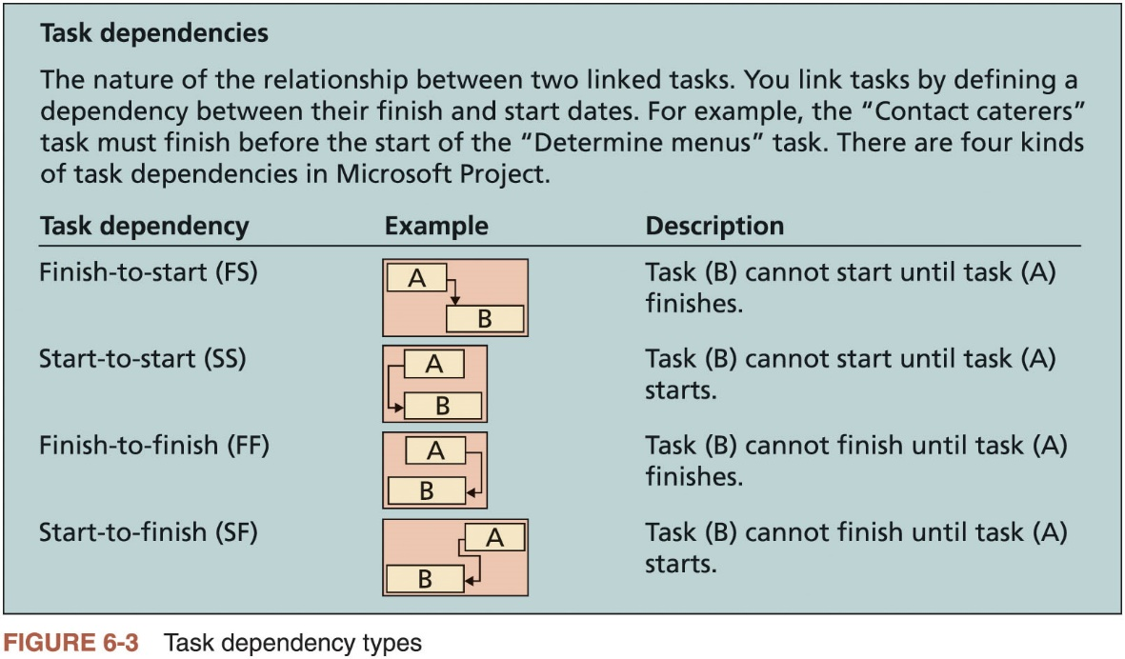
Sequencing Activities (5 of 6)

Slide 15
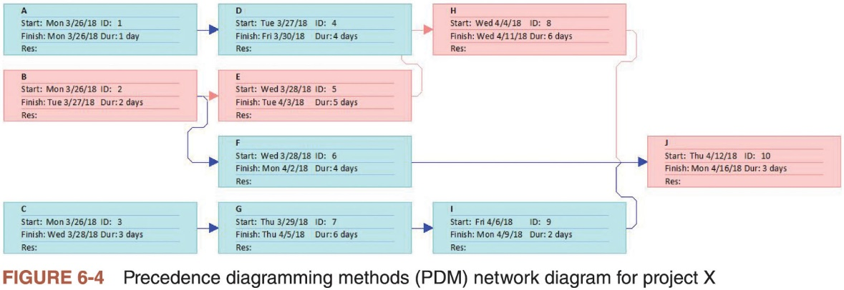
Sequencing Activities (6 of 6)

Slide 16
Estimating Activity Durations
Duration includes the actual amount of time worked on an activity plus elapsed time
Effort is the number of workdays or work hours required to complete a task and does not normally equal duration
People doing the work should help create estimates
An expert should review them
A three-point estimate is an estimate that includes an optimistic, most likely, and pessimistic estimate
Three-point estimates are needed for PERT and Monte Carlo simulations

Slide 17
Developing the Schedule
Uses results of the other time management processes to determine the start and end date of the project
Ultimate goal is to create a realistic project schedule that provides a basis for monitoring project progress for the time dimension of the project
Important tools and techniques
Gantt charts
Critical path analysis
Critical chain scheduling
PERT analysis

Slide 18
Gantt Charts (1 of 5)
Provide a standard format for displaying project schedule information by listing project activities and corresponding start and finish dates in a calendar form
Symbols
Black diamond: milestones
Thick black bars: summary tasks
Light gray horizontal bars: durations of tasks
Arrows: dependencies between tasks

Slide 19
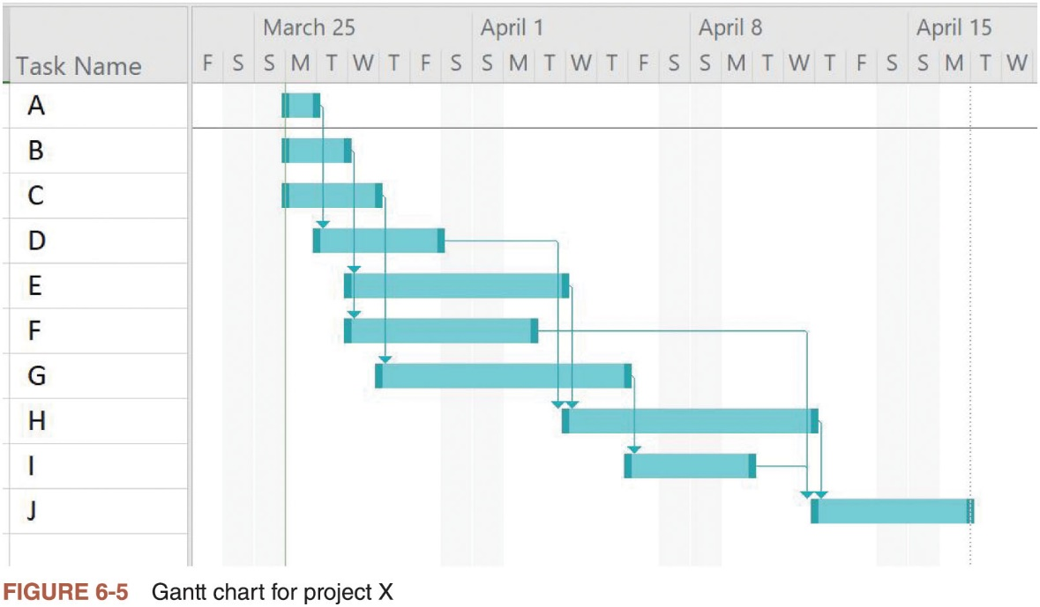
Gantt Charts (2 of 5)

Slide 20
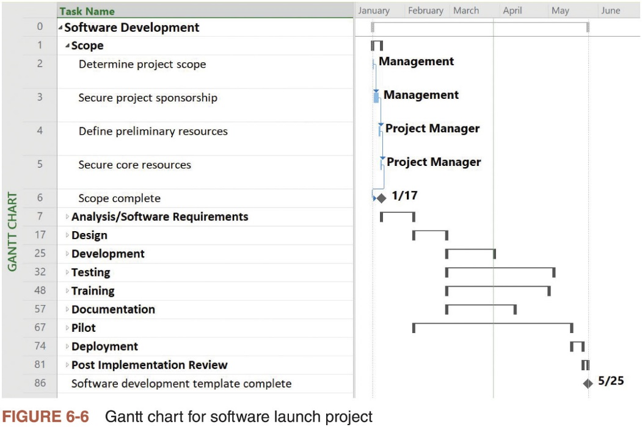
Gantt Charts (3 of 5)

Slide 21
Gantt Charts (4 of 5)
Adding milestones to Gantt charts
Many people like to focus on meeting milestones, especially for large projects
Milestones emphasize important events or accomplishments on projects
SMART Criteria for milestones
Specific
Measurable
Assignable
Realistic
Time-framed

Slide 22
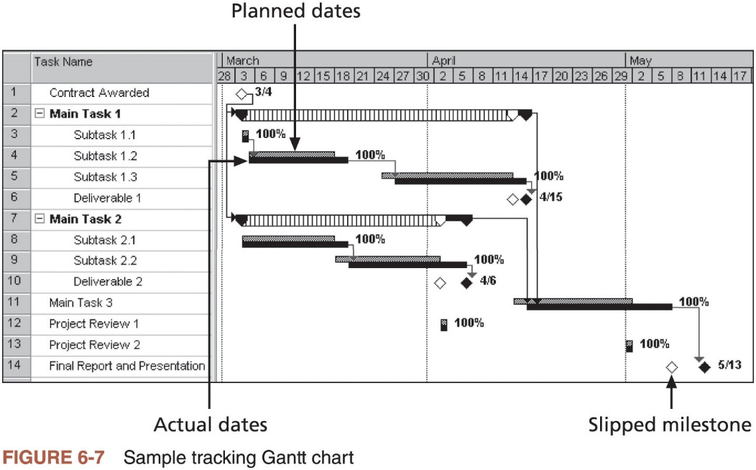
Gantt Charts (5 of 5)

Slide 23
Critical Path Method (CPM) (1 of 2)
Network diagramming technique used to predict total project duration
Critical path: series of activities that determine the earliest time by which the project can be completed
The longest path through the network diagram and has the least amount of slack or float; amount of time an activity may be delayed without delaying a succeeding activity or the project finish date
Calculating the critical path
Develop a good network diagram and add the duration estimates for all activities on each path through the network diagram
Longest path is the critical path
If one or more of the activities on the critical path takes longer than planned, the whole project schedule will slip unless the project manager takes corrective action

Slide 24
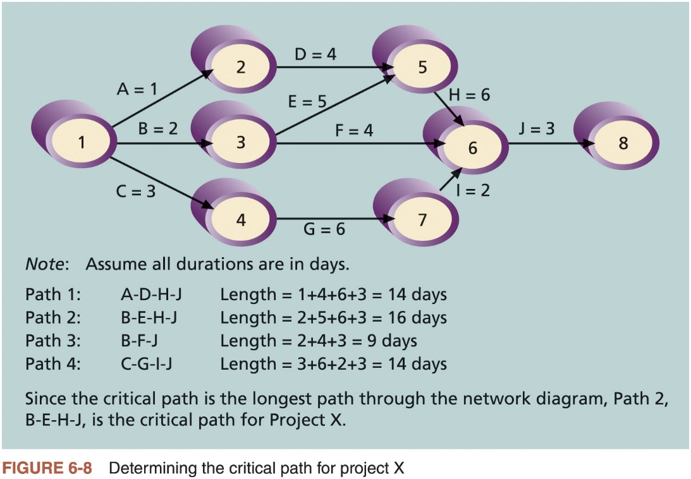
Critical Path Method (CPM) (2 of 2)

Slide 25
Growing Grass Can Be on the Critical Path
The fact that its name includes the word critical does not mean that it includes all critical activities
Only accounts for time
Example: growing grass for Disney’s Animal Kingdom
There can be more than one critical path if the lengths of two or more paths are the same
Project managers should closely monitor performance of activities on the critical path to avoid late project completion
Critical path can change as the project progresses

Slide 26
Using Critical Path Analysis to Make Schedule Trade-Offs (1 of 3)
Free slack or free float
Amount of time an activity can be delayed without delaying the early start of any immediately following activities
Total slack or total float
Amount of time an activity may be delayed from its early start without delaying the planned project finish date
Forward pass
Determines the early start and finish dates
Backward pass
Determines the late start and finish dates

Slide 27
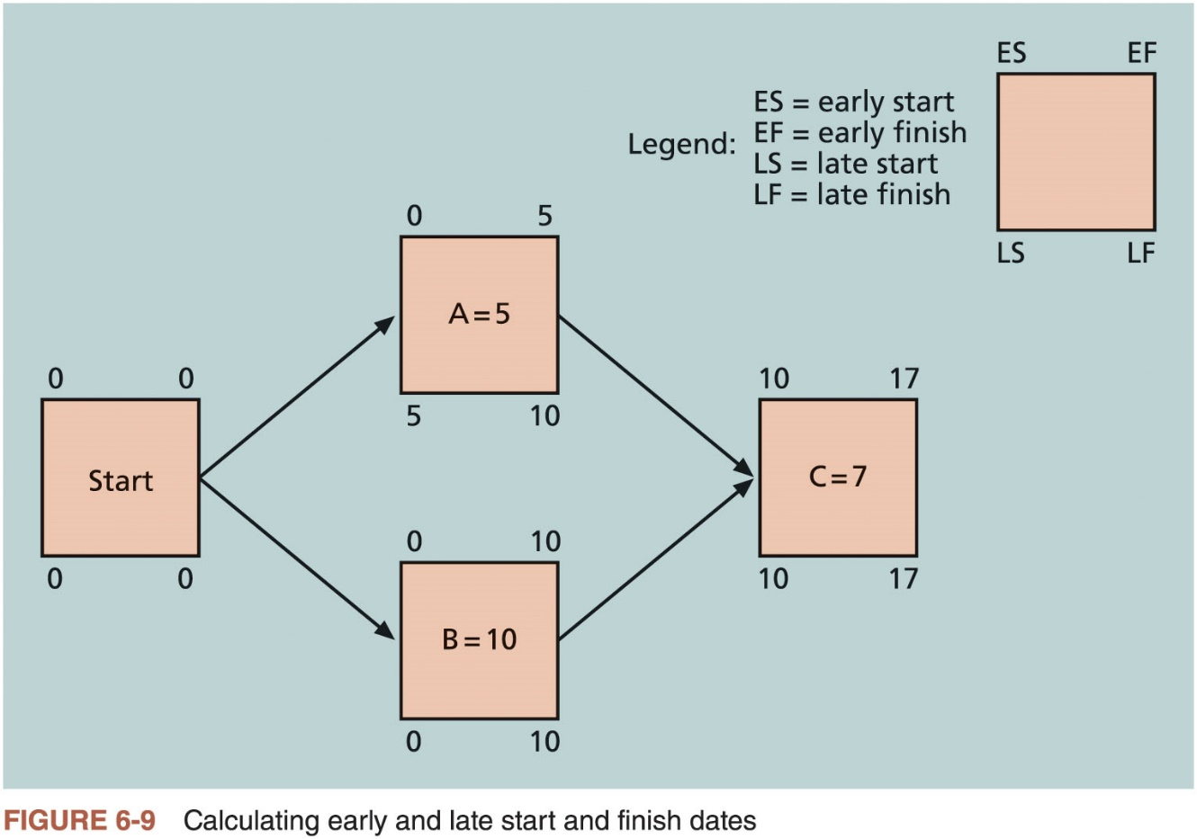
Using Critical Path Analysis to Make Schedule Trade-Offs (2 of 3)

Slide 28
Using Critical Path Analysis to Make Schedule Trade-Offs (3 of 3)
Task Name | Start | Finish | Late Start | Late Finish | Free Slack | Total Slack
A | 8/3/15 | 8/3/15 | 8/5/15 | 8/5/15 | 0d | 2d
B | 8/3/15 | 8/4/15 | 8/3/15 | 8/4/15 | 0d | 0d
C | 8/3/15 | 8/5/15 | 8/5/15 | 8/7/15 | 0d | 2d
D | 8/4/15 | 8/7/15 | 8/6/15 | 8/11/15 | 2d | 2d
E | 8/5/15 | 8/11/15 | 8/5/15 | 8/11/15 | 0d | 0d
F | 8/5/15 | 8/10/15 | 8/14/15 | 8/17/15 | 7d | 7d
G | 8/6/15 | 8/13/15 | 8/10/15 | 8/17/15 | 0d | 2d
H | 8/12/15 | 8/19/15 | 8/12/15 | 8/19/15 | 0d | 0d
I | 8/14/15 | 8/17/15 | 8/18/15 | 8/19/15 | 2d | 2d
J | 8/20/15 | 8/24/15 | 8/20/15 | 8/24/15 | 0d | 0d
Table 6-1 Free and Total Float or Slack for Project X

Slide 29
Using the Critical Path to Shorten a Project Schedule
Main techniques for shortening schedules
Shortening durations of critical activities/tasks by adding more resources or changing their scope
Crashing activities by obtaining the greatest amount of schedule compression for the least incremental cost
Fast tracking activities by doing them in parallel or overlapping them

Slide 30
Importance of Updating Critical Path Data
It is important to update the schedule with actual data
Note actual activity durations as they are completed
Revise estimates for activities in progress
Monitor changes to make informed decisions

Slide 31
Critical Chain Scheduling (1 of 4)
Considers limited resources when creating a project schedule and includes buffers to protect the project completion date
Uses the Theory of Constraints (TOC): management philosophy developed by Eliyahu M. Goldratt; attempts to minimize multitasking when a resource works on more than one task at a time

Slide 32
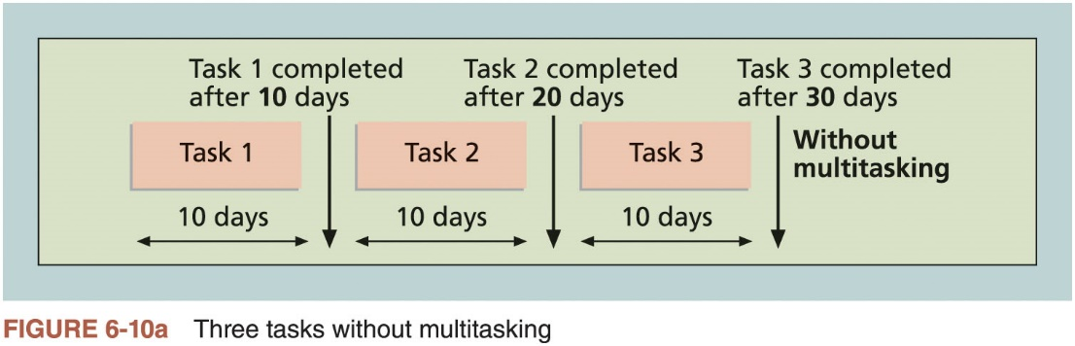
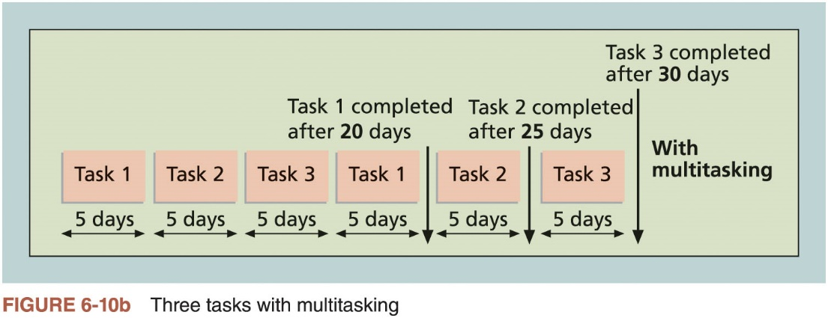
Critical Chain Scheduling (2 of 4)

Slide 33
Critical Chain Scheduling (3 of 4)
Additional concepts
Buffer: additional time to complete a task
Murphy’s Law: if something can go wrong, it will
Parkinson’s Law: work expands to fill the time allowed
Project buffer: additional time added before the project’s due date
Feeding buffers: additional time added before tasks on the critical path

Slide 34
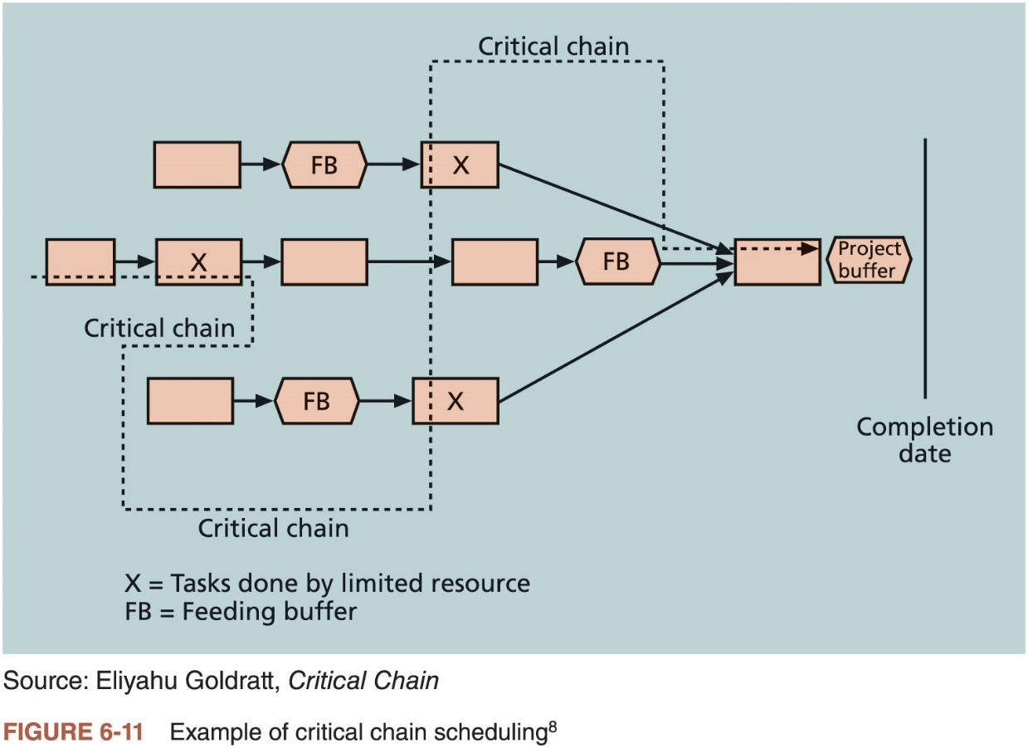
Critical Chain Scheduling (4 of 4)

Slide 35
Program Evaluation and Review Technique (PERT)
Network analysis technique used to estimate project duration when there is a high degree of uncertainty about the individual activity duration estimates
Uses probabilistic time estimates: duration estimates based on using optimistic, most likely, and pessimistic estimates of activity durations
By using the PERT weighted average for each activity duration estimate, total project duration estimate takes into account the risk or uncertainty in the individual activity estimates

Slide 36
Agile and Schedule Management
Core values of the Manifesto for Agile Software Development
Customer collaboration over contract negotiation
Responding to change over following a plan
Example: product owner defines and prioritizes the work to be done within a sprint
Collaboration and time management are designed into the process

Slide 37
Controlling the Schedule
Goals of schedule control
Know the status of the schedule
Influence the factors that cause schedule changes
Determine that the schedule has changed
Manage changes when they occur
Main inputs to schedule control
Project management plan
Project documents
Work performance data
Organizational process assets

Slide 38
Reality Checks on Scheduling and the Need for Discipline
Important activities
Review the draft schedule or estimated completion date in the project charter
Prepare a more detailed schedule with the project team
Make sure the schedule is realistic and followed
Alert top management well in advance if there are schedule problems

Slide 39
Using Software to Assist in Project Schedule Management
Software for facilitating communications helps people exchange schedule-related information
Decision support models help analyze trade-offs that can be made to address schedule issues
Project management software can help in various time management areas

Slide 40
Global Issues
Microsoft tells the customer story of Mexico’s Secretary of Economy, who wanted to ensure that IT initiatives aligned with business goals and improved project management efficiency
After implementing new software, their IT team could handle four times the number of concurrent projects without adding more staff

Slide 41
Words of Caution on Using Project Management Software
Many people misuse project management software because they don’t understand important concepts and have not had training
Example: dependencies must be entered to have dates adjust automatically and to determine the critical path
Many project management software programs come with templates or sample files
It is very easy to use these files without considering unique project needs
Project managers and their teams should be careful not to rely too much on templates or sample files and ignore the unique concerns of their particular projects

Slide 42
Considerations for Agile/Adaptive Environments
Schedule management is radically different using Agile and Scrum
Projects that rely heavily on the critical path method consider meeting the project’s estimated completion date as a crucial component of success
Agile projects may not even need to estimate activity durations or project schedules at all; overall project completion time is not important

Slide 43
Chapter Summary
Project time management is often cited as the main source of conflict on projects
Most IT projects exceed time estimates
Main processes
Plan schedule management
Define activities
Sequence activities
Estimate activity resources
Estimate activity durations
Develop schedule
Control schedule

